Slide 1
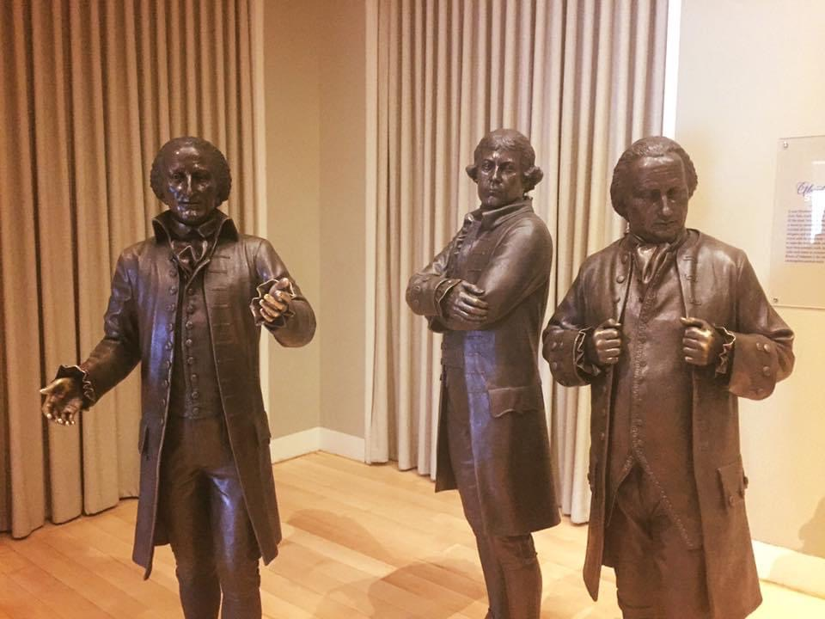
Edmund Randolph
Elbridge Gerry
George Mason

