Slide 1
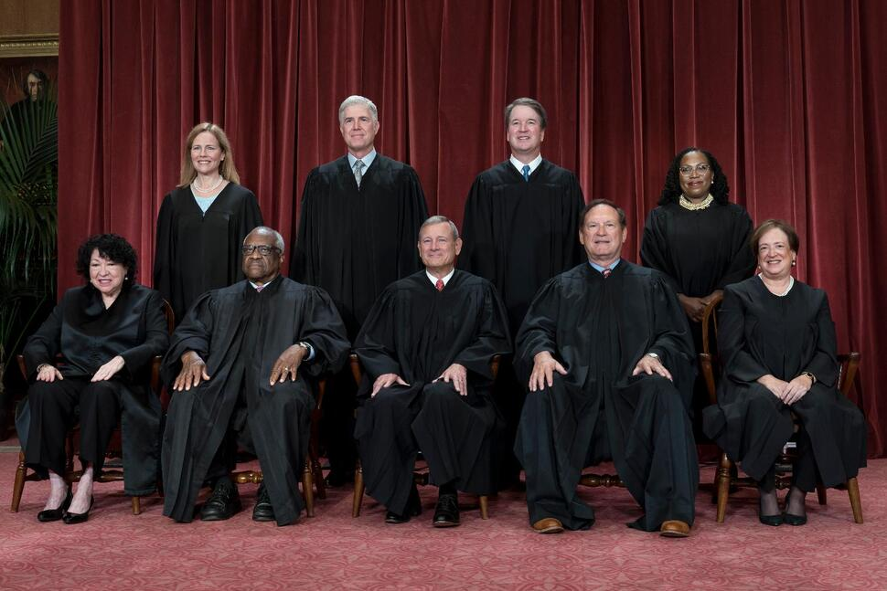
SCOTUS “CLASS PHOTO”
The Roberts Court in 2022

Slide 2
SCOTUS “CLASS PHOTO”
Appointed by : Year:
John G. Roberts, Jr. George W. Bush 2005
Clarence Thomas George H.W. Bush 1991
Samuel A. Alito, Jr. George W. Bush 2006
Sonia Sotomayor Barack Obama 2009
Elena Kagan Barack Obama 2010
Neil M. Gorsuch Donald Trump 2017
Brett M. Kavanaugh Donald Trump 2018
Amy Coney Barrett Donald Trump 2020
Ketanji Brown Jackson Joseph Biden 2022
8
6
7
9
4
2
1
3
5

Slide 3
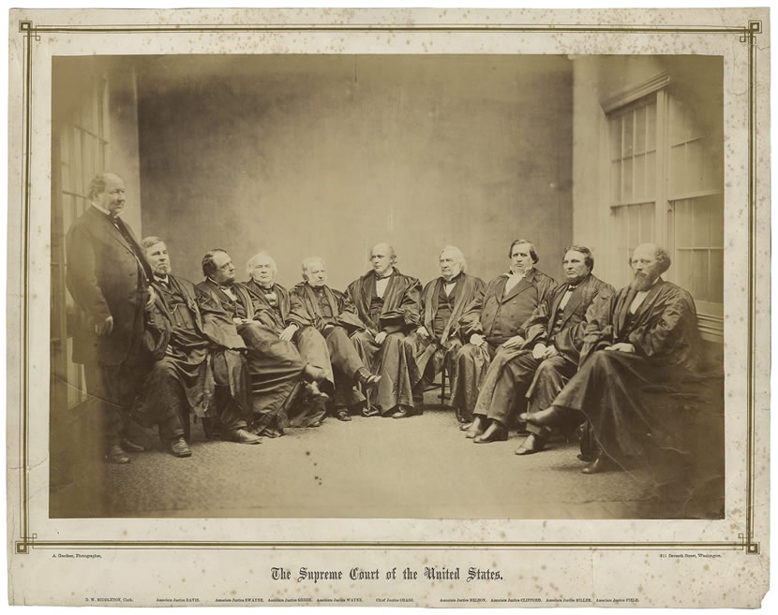
The Chase Court in 1867

Slide 4
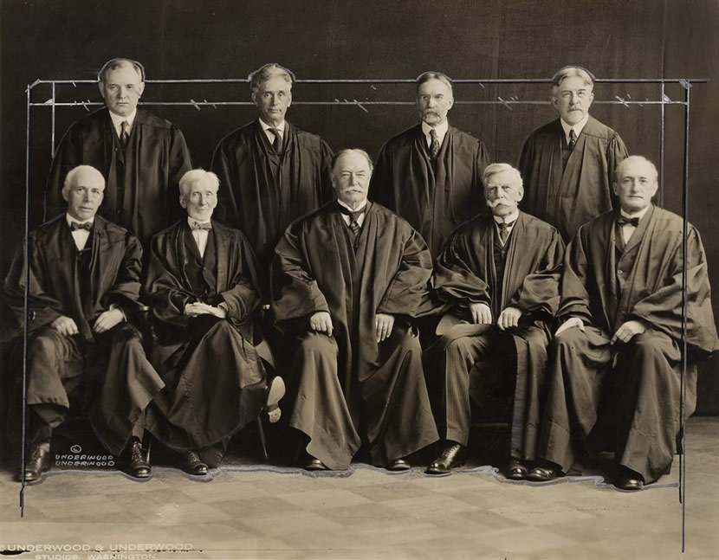
The Taft Court in 1923

Slide 5
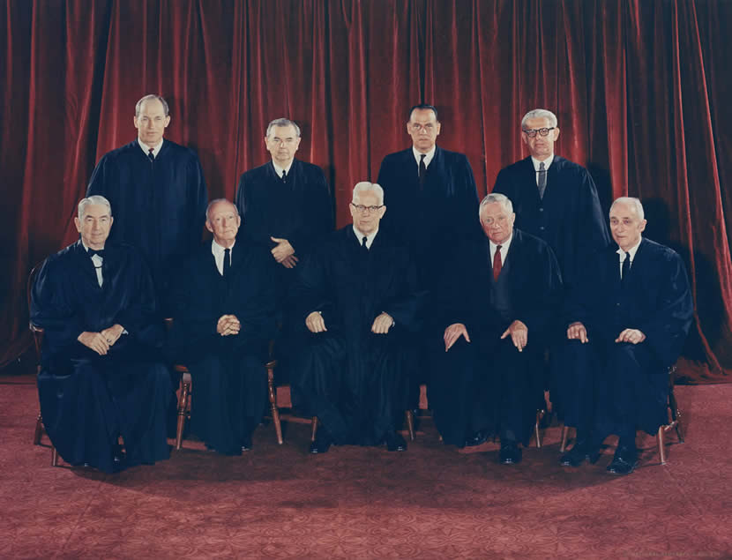
The Warren Court in 1965

Slide 6
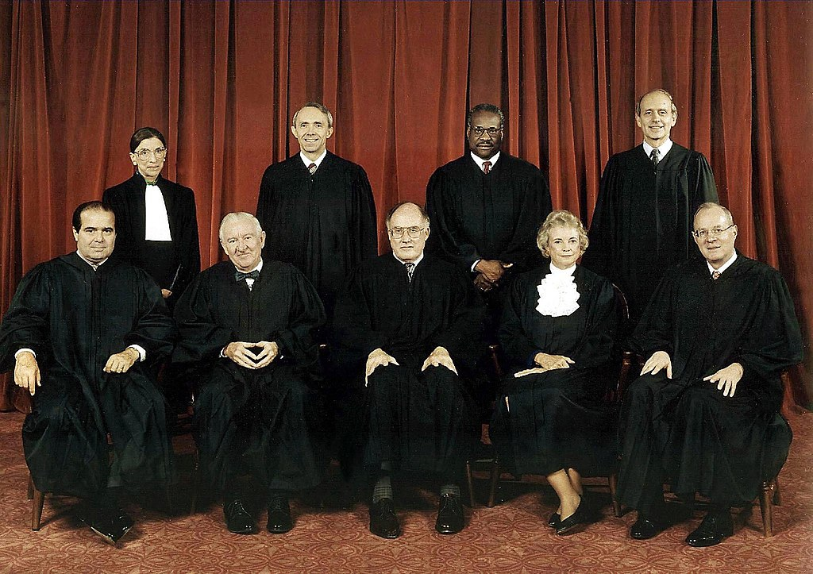
The Rehnquist Court in 1998

