Slide 1
BUILD YOUR OWN EXHIBIT ON RECONSTRUCTION
Notes:
Building an exhibit activity:
Questions to consider:
How do we balance the oppression and resistance?
How do we help students build a strong historical foundation, aware of the whole history (historiography).
https://www.youtube.com/watch?v=mqXBT7CB0X4

Slide 2
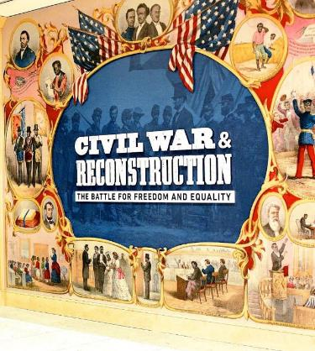
BUILD YOUR OWN EXHIBIT ON RECONSTRUCTION
The 14th Amendment’s powerful language transformed the Constitution forever. In this activity, you will design your own museum exhibit to teach about the history and significance of the 14th Amendment.
Follow the instructions below to help build your 14th Amendment museum exhibit. As you go, check out these additional resources from the National Constitution Center:
Interactive Constitution 14th Amendment
Drafting Table
Founder’s Library: Civil War and Reconstruction Documents
Civil War and Reconstruction Exhibit
Virtual Tour of the Civil War.

Slide 3
BUILD YOUR OWN EXHIBIT ON RECONSTRUCTION
Here are some key questions to think about throughout the exercise:
Who is the story about?
What point of view are you taking?
What goes wrong?
What events happen?
What details will you share and what will you let go of?
How does it end?
Why does this story matter to the audiences engaging with the exhibit?

Slide 4
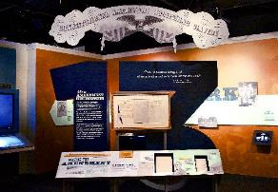
BUILD YOUR OWN EXHIBIT ON RECONSTRUCTION
STEP ONE:
To begin, decide as a class how you are going to organize your exhibit. For instance, you could tell the story of the 14th Amendment through a timeline, you could divide your exhibit into sections based on the four big ideas of the amendment, or you might choose to focus your exhibit on the related landmark Supreme Court cases.
STEP TWO:
Next, it’s time to curate your exhibit by choosing the people, events, primary sources, and/or Supreme Court cases that you feel should be included in your exhibit. Discuss as a class which subjects will help highlight the 14th Amendment’s full story. Once you have a final list of subjects, assign them to individual students.

Slide 5
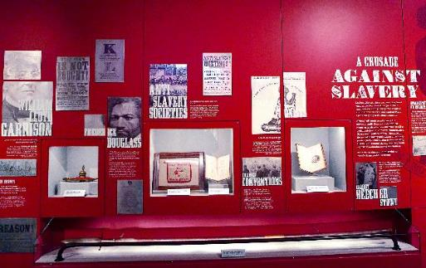
BUILD YOUR OWN EXHIBIT ON RECONSTRUCTION
STEP THREE:
Now, it’s time to start building your display for the exhibit. Research the individual subject you were assigned, and create a display about it. This display can include text, photographs, objects, interactive activities, and more. (Hint: For inspiration, think about interesting displays that you have seen when you’ve visited museums.)
Use one or more of the following slides to build your virtual display.

Slide 7
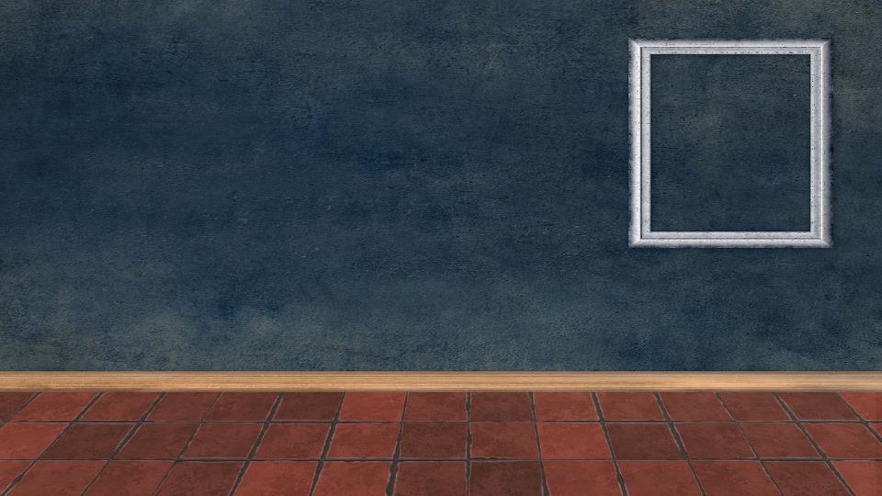

Slide 9
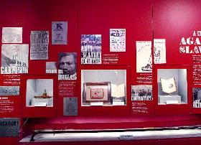
BUILD YOUR OWN EXHIBIT ON RECONSTRUCTION
STEP FOUR:
After the individual displays are complete, come back together as a class to set up your museum exhibit!
Put your slides back together in one presentation to build your virtual museum! Remember to follow the organizational model you agreed on in Step One.
Once the museum exhibit is complete, enjoy exploring it like a visitor. View your classmates' displays, and let the exhibit spark conversations about the 14th Amendment.

