Slide 1
Fourth Amendment
Privacy in a Digital Age, Policing in America, Search and Seizure
4th Amendment - Privacy in a Digital Age,
Policing in America,
Search and Seizure

Slide 2
Big Questions
Why did the Framers put the Fourth Amendment in the Bill of Rights?
What was the Founding generation’s vision for the Fourth Amendment and its protection against unreasonable searches and seizures?
When does the Fourth Amendment allow the government to search you or seize your property?
When is a government’s search of seizure “reasonable”?
4th Amendment - Privacy in a Digital Age,
Policing in America,
Search and Seizure

Slide 3
Big Questions (cont.)
How has the Supreme Court interpreted the Fourth Amendment over time? And how has it dealt with the challenge of shaping the Fourth Amendment’s meaning in light of new technologies, especially as it applies to public schools?
4th Amendment - Privacy in a Digital Age,
Policing in America,
Search and Seizure

Slide 4
Fourth Amendment
The right of the people to be secure
in their persons, houses, papers, and effects, against unreasonable searches and seizures, shall not be violated, and no Warrants shall issue, but upon probable cause, supported by Oath or affirmation, and particularly describing the place to be searched, and the persons or things to be seized.
4th Amendment - Privacy in a Digital Age,
Policing in America,
Search and Seizure

Slide 5
Breaking Down the Fourth Amendment
Which things are protected: Persons, houses, papers, and effects.
What are “effects”? They’re our stuff.
Against what: unreasonable searches and seizures by the government.
Who’s the government here? Usually police officers.
4th Amendment - Privacy in a Digital Age,
Policing in America,
Search and Seizure

Slide 6
The Warrant Requirement
The Fourth Amendment places restraints on the government any time it searches or seizes a person or her property. True to the Amendment’s text, the government’s search or seizure must be reasonable.
The warrant requirement itself ensures that searches and seizures are generally cleared in advance by a judge. To get a warrant from a judge, the government must show “probable cause.”
4th Amendment - Privacy in a Digital Age,
Policing in America,
Search and Seizure

Slide 7
Probable Cause
“Probable cause” simply means a certain level of suspicion of criminal activity—to justify a particular search or a particular seizure. Its suspicion that attaches to a particular person, place, or item—for instance.
4th Amendment - Privacy in a Digital Age,
Policing in America,
Search and Seizure

Slide 8
Can they do that?
When thinking about the Fourth Amendment, we often start with a simple question: Can they do that?
Can police officers stop me on the street?
Can they search my car, my desk, or my nightstand?
Can they look at who I’ve called, where I’ve been, or what I’ve written?
4th Amendment - Privacy in a Digital Age,
Policing in America,
Search and Seizure

Slide 9
Big Idea
Before the government can search your home or seize your property, it needs a good reason. This is the big idea behind the Fourth Amendment’s warrant requirement. The government needs particularized suspicion—a reason that’s specific to each suspect—before it can get a warrant. Broadly speaking, our Constitution says that the police should only be able to invade a person’s rights to privacy, property, or liberty if they have a specific reason to think that the suspect has done something wrong.
4th Amendment - Privacy in a Digital Age,
Policing in America,
Search and Seizure

Slide 10
Hypothetical
Can the government track you 24 hours a day, 7 days a week, for an entire month, using your cell phone data and location information?
(Carpenter v. United States, 2018)
4th Amendment - Privacy in a Digital Age,
Policing in America,
Search and Seizure
VOTE NOW!

Slide 11
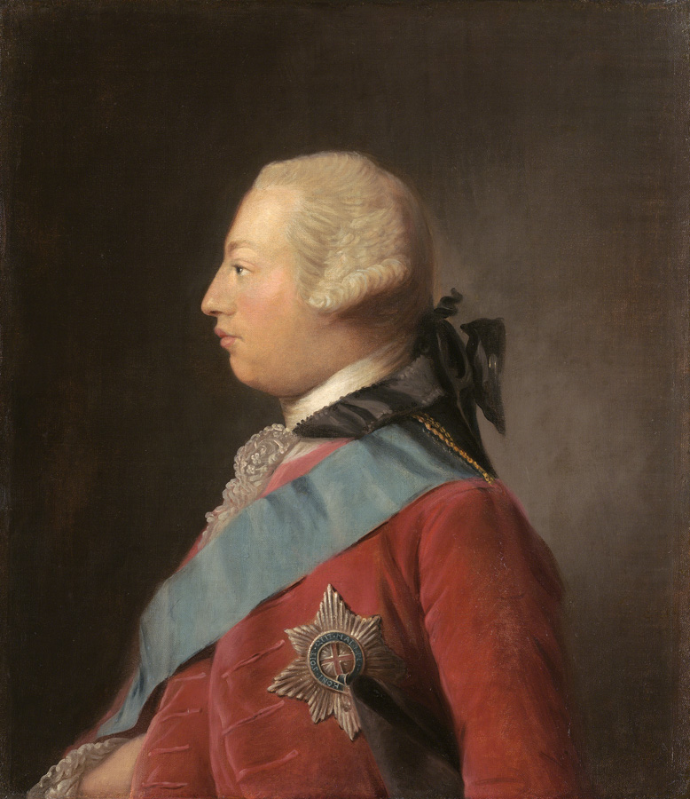
Writs of Assistance
Boston, 1761 King George was using royal officials in the colonies to crack down on tax evaders and smugglers with the use of so-called “Writs of Assistance.” Writs of Assistance gave royal officials “free range” to break into the homes of colonists to search for evidence…anytime, anywhere, and for any reason.
4th Amendment - Privacy in a Digital Age,
Policing in America,
Search and Seizure
King George III

Slide 12
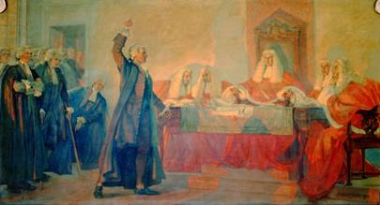
Writs of Assistance
4th Amendment - Privacy in a Digital Age,
Policing in America,
Search and Seizure
James Otis, a prominent Boston lawyer, publicly denounced the Writs of Assistance

Slide 13
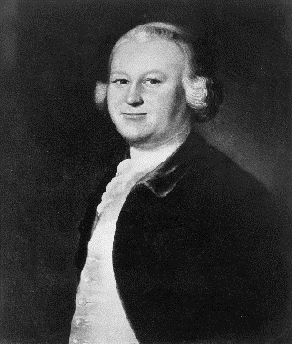
Writs of Assistance
“It is a power that places the liberty of every man in the hands of every petty officer.”
4th Amendment - Privacy in a Digital Age,
Policing in America,
Search and Seizure
James Otis
Notes:
https://www.britannica.com/biography/James-Otis

Slide 14
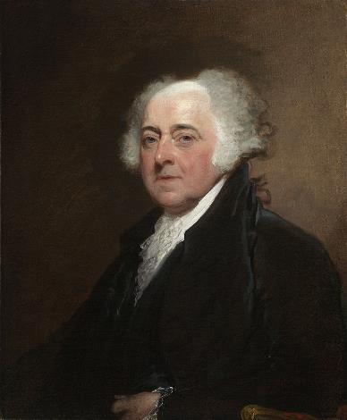
Writs of Assistance
Otis’s argument was “the first scene of the first act of opposition to the arbitrary claims of Great Britain. Then and there the child of Independence was born.”
4th Amendment - Privacy in a Digital Age,
Policing in America,
Search and Seizure
John Adams
Notes:
https://www.britannica.com/biography/James-Otis

Slide 15
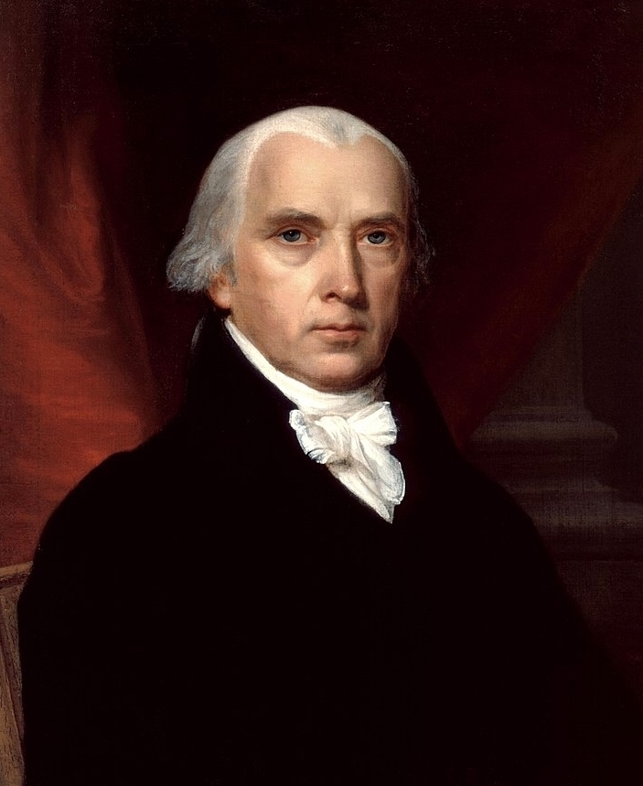
The Founding Era and General Warrants
Like Otis, James Madison and the Founding generation were primarily concerned about general warrants.
These warrants had allowed royal agents to conduct broad searches without limits and thus giving them arbitrary power to wield at disfavored colonists.
4th Amendment - Privacy in a Digital Age,
Policing in America,
Search and Seizure
James Madison
Notes:
https://www.britishmuseum.org/collection/object/P_Cc-3-38
https://www.npg.org.uk/collections/search/portrait/mw195879/John-Wilkes

Slide 16
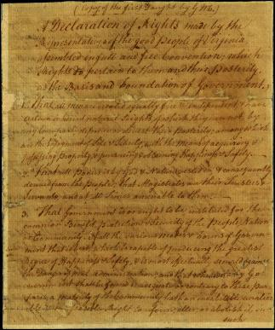
The Founding Era and General Warrants
The Virginia Declaration of Rights banned “general warrants, whereby an officer or messenger may be commanded to search suspected places without evidence of fact committed.”
4th Amendment - Privacy in a Digital Age,
Policing in America,
Search and Seizure
Virginia Declaration of Rights

Slide 17
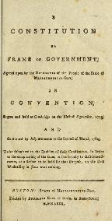
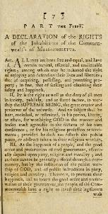
The Founding Era and General Warrants
Several state constitutions—including those in Massachusetts and Pennsylvania—opened with a Preamble similar to the first clause of the Fourth Amendment, declaring the right of the people to be free from oppressive search and seizures.
The message here was simple. Warrants were often the instruments of tyranny.
4th Amendment - Privacy in a Digital Age,
Policing in America,
Search and Seizure
Massachusetts Constitution of 1780

Slide 18
Big Idea
Before the government can search your home or seize your property, it needs a good reason.
4th Amendment - Privacy in a Digital Age,
Policing in America,
Search and Seizure

Slide 19
Basic Framework for Analyzing Fourth Amendment Cases
Was there a search or seizure?
Entering someone’s home to look for evidence is a search, but passively observing someone in plain view in public is not.
When the government restrains someone or takes her property, there’s a seizure. When the government doesn’t, there isn’t.
If there’s no search or seizure, then there’s no Fourth Amendment violation.
4th Amendment - Privacy in a Digital Age,
Policing in America,
Search and Seizure

Slide 20
Basic Framework for Analyzing Fourth Amendment Cases
Was the search or seizure reasonable?
Generally, the police need to go to a judge and secure a warrant supported by probable cause before searching a home or seizing property. Probable cause requires a “fair probability” that, for instance, the relevant evidence of a crime will be found in the place (or thing) to be searched.
There are times when a warrant is not required: the police may search you during an arrest. Or at a check point. Or when there’s imminent danger that someone might be hurt, a suspect might flee, or evidence might be destroyed—as in a drug raid.
4th Amendment - Privacy in a Digital Age,
Policing in America,
Search and Seizure

Slide 21
Basic Framework for Analyzing Fourth Amendment Cases
If there’s a Fourth Amendment violation, what happens next?
Generally, courts will apply what’s known as the exclusionary rule—throwing out evidence in a criminal trial that the police got by violating the Fourth Amendment. This is meant as a check on police abuses.
But again, there are exceptions, for example, if police officers were acting in good faith and made a mistake.
4th Amendment - Privacy in a Digital Age,
Policing in America,
Search and Seizure

Slide 22
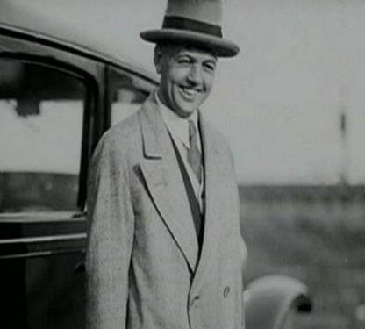
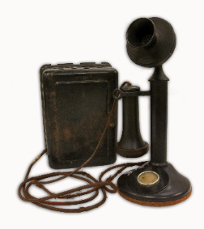
Olmstead v. United States (1928)
4th Amendment - Privacy in a Digital Age,
Policing in America,
Search and Seizure
ROY OLMSTEAD

Slide 23
Olmstead v. United States (1928)
Facts of the Case: Olmstead took place in 1928 during the height of Prohibition
Federal agents were investigating Roy Olmstead for running an illegal liquor business. Without a judicial warrant, they installed “wiretaps” on the phone lines leading to the office of the suspected illegal business, as well as to Olmstead’s home.
Able to listen to the suspects’ phone conversations, the agents uncovered evidence that Olmstead was selling liquor.
Olmstead argued that this violated the Fourth Amendment. He lost.
4th Amendment - Privacy in a Digital Age,
Policing in America,
Search and Seizure

Slide 24
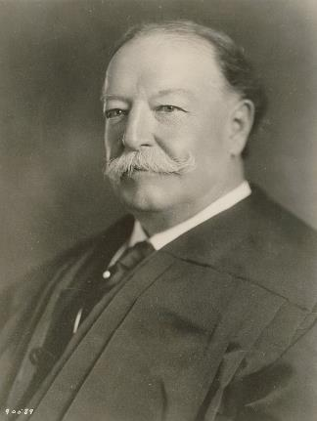
Olmstead v. United States (1928)
Majority Opinion:
No physical trespass, no constitutional violation.
The Founding generation linked Fourth Amendment protections to property rights, and Taft argued that the Court should do the same.
4th Amendment - Privacy in a Digital Age,
Policing in America,
Search and Seizure
CHIEF JUSTICE WILLIAM HOWARD TAFT

Slide 25
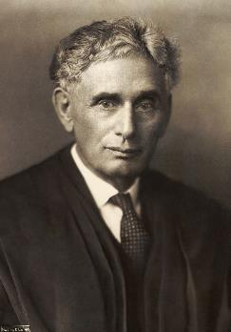
Olmstead v. United States (1928)
Brandeis Dissent:
“Progress of science and espionage is not likely to stop with wiretapping. Ways may some day be developed by which the government without physically intruding into the home may extract secret records and introduce them into Court.”
4th Amendment - Privacy in a Digital Age,
Policing in America,
Search and Seizure
JUSTICE LOUIS BRANDEIS

Slide 26
Olmstead v. United States (1928)
Brandeis Dissent:
“At the time of the Framing, a far smaller intrusion—the general warrants that sparked the American Revolution—were held to be unconscionable violations of liberty. Can it be that the Constitution does not afford protections against similar invasions in light of new technology?”
4th Amendment - Privacy in a Digital Age,
Policing in America,
Search and Seizure
JUSTICE LOUIS BRANDEIS

Slide 27
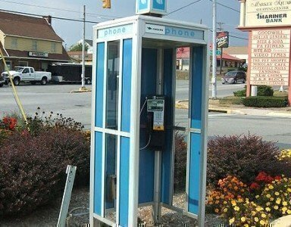
Katz v. United States (1967)
4th Amendment - Privacy in a Digital Age,
Policing in America,
Search and Seizure

Slide 28
Katz v. United States (1967)
Facts of the Case:
Acting on a suspicion that Charles Katz was transmitting gambling information over the phone to clients in other states, federal agents attached an eavesdropping device to the outside of a public phone booth used by Katz. Based on recordings of his end of the conversation, Katz was convicted for illegal gambling.
Katz argued that the government violated the Fourth Amendment by listening in on his conversation.
The Supreme Court agreed. And in the process, it overruled Olmstead and its requirement of a physical trespass.
4th Amendment - Privacy in a Digital Age,
Policing in America,
Search and Seizure

Slide 29
Katz v. United States (1967)
The Court ruled that Katz was entitled to Fourth Amendment protection for his conversations and that a physical intrusion into the area he occupied was unnecessary to bring the Amendment into play (Overruling Olmstead and its requirement of a physical trespass).
Although a public phone booth is a public space rather than private property, individuals have a strong expectation that such conversations will not be overheard.
The Fourth Amendment protects people, not places.
4th Amendment - Privacy in a Digital Age,
Policing in America,
Search and Seizure

Slide 30
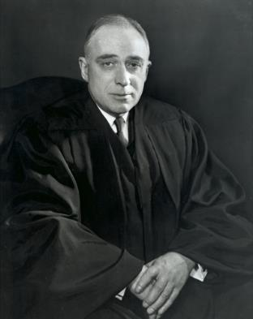
Katz v. United States (1967)
In an influential separate opinion—a concurrence—Justice Harlan said that Fourth Amendment protections apply whenever the individual has a “reasonable expectation of privacy.”
4th Amendment - Privacy in a Digital Age,
Policing in America,
Search and Seizure
JUSTICE JOHN MARSHALL HARLAN II

Slide 31
Justice Harlan’s Katz Test
Did the individual have a subjective expectation of privacy?
Was the expectation of privacy one that society would recognize as reasonable?
4th Amendment - Privacy in a Digital Age,
Policing in America,
Search and Seizure
JUSTICE JOHN MARSHALL HARLAN II

Slide 32
Third Party Doctrine Cases
When the government tries to obtain “third-party” information—such as bank records or pen registers—that is generally not a search for Fourth Amendment purposes. And therefore, the government doesn’t need to get a warrant before getting access to that information.
4th Amendment - Privacy in a Digital Age,
Policing in America,
Search and Seizure
United States v. Miller (1976)
Smith v. Maryland (1979)

Slide 33
New Technology Cases
How do we apply the Fourth Amendment’s text and traditional Fourth Amendment principles to the new challenges of the digital age?
Jones v. United States (2012)
Riley v. California (2014)
4th Amendment - Privacy in a Digital Age,
Policing in America,
Search and Seizure

Slide 34
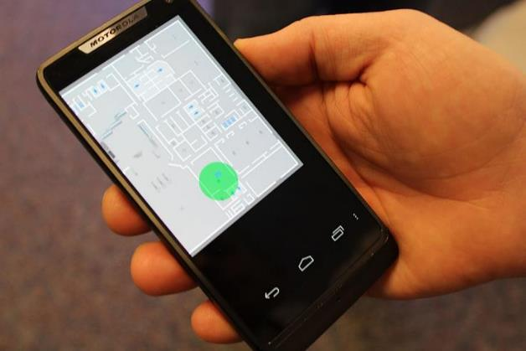
Carpenter v. United States (2018)
4th Amendment - Privacy in a Digital Age,
Policing in America,
Search and Seizure

Slide 35
Hypothetical
Can the government track you 24 hours a day, 7 days a week, for an entire month, using your cell phone data and location information?
(Carpenter v. United States, 2018)
4th Amendment - Privacy in a Digital Age,
Policing in America,
Search and Seizure
VOTE NOW!

Slide 36
Carpenter v. United States (2018)
Facts of the Case: In Carpenter, police officers arrested four men in a string of armed robberies. One of these men confessed. He gave his cell phone to the FBI and gave the agents the cell phone numbers of many of his accomplices. The FBI then used this information—and the suspect’s call log—to get the cell phone records of many other suspects.
Importantly, the government didn’t get a warrant. Instead, they requested this data through a national law—the Stored Communications Act. By using this law, the government only had to say that the cell phone records were relevant to a legitimate criminal investigation. This “relevance” standard is lower than the test for getting a warrant—known as “probable cause.”
The police eventually arrested Timothy Carpenter. And he was convicted and sentenced to 116 years in prison.
4th Amendment - Privacy in a Digital Age,
Policing in America,
Search and Seizure

Slide 37
Carpenter v. United States (2018)
Carpenter asked the question:
Can they do that?
Can the FBI gain access to my cell phone records without a warrant?
4th Amendment - Privacy in a Digital Age,
Policing in America,
Search and Seizure

Slide 38
Carpenter v. United States (2018)
In a 5-4 decision—authored by Chief Justice John Roberts—the Supreme Court ruled that the practice of acquiring cell phone location information from wireless service providers is a Fourth Amendment search because it violates a person’s “legitimate expectation of privacy in the record of his physical movements.” The Court also ruled that accessing those records without a warrant violates the Fourth Amendment.
4th Amendment - Privacy in a Digital Age,
Policing in America,
Search and Seizure

Slide 39
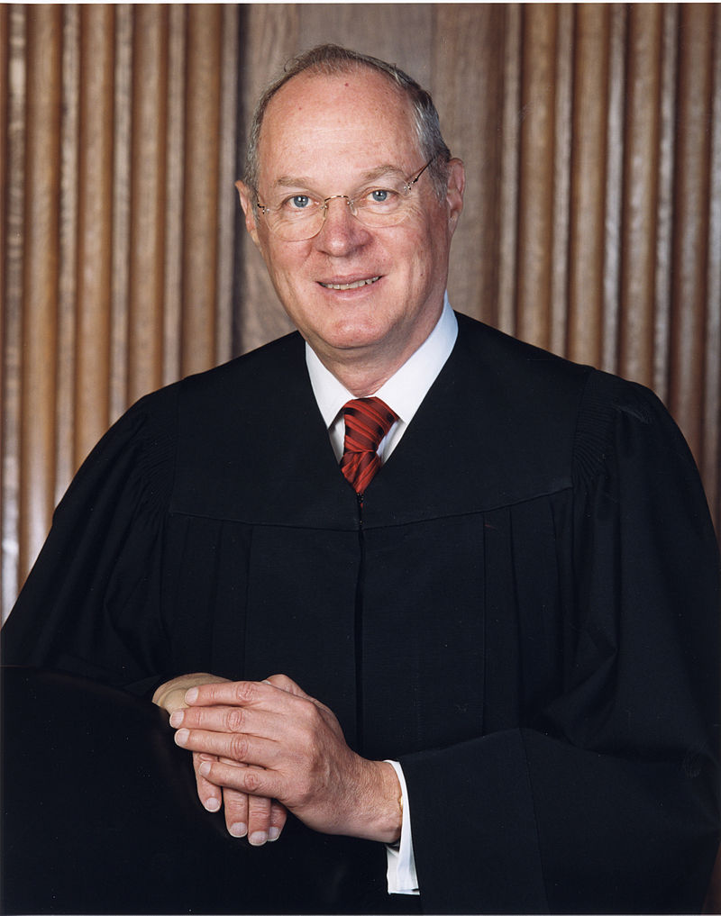
Carpenter v. United States (2018)
Dissenting:
Justice Kennedy argued that cell-site records are no different from the many other kinds of business records the government has a lawful right to obtain without a warrant because he believed users had in fact voluntarily given away their records to third-party businesses.
4th Amendment - Privacy in a Digital Age,
Policing in America,
Search and Seizure
JUSTICE ANTHONY KENNEDY

Slide 40
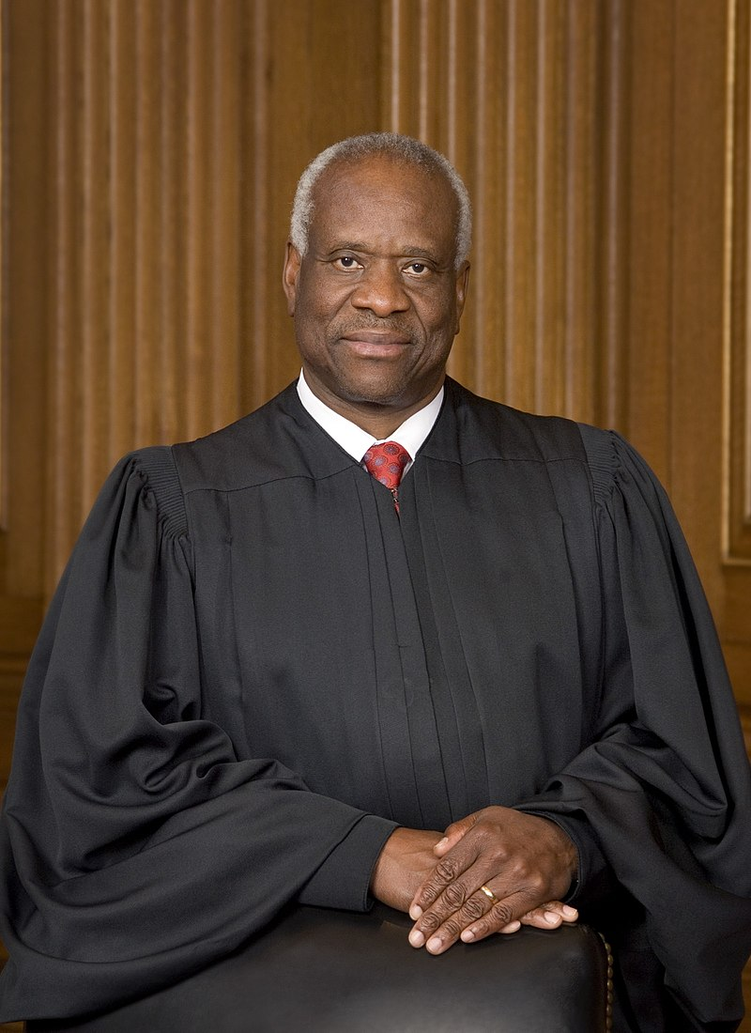
Carpenter v. United States (2018)
Dissenting:
Justice Thomas also stressed a property-based approach to Fourth Amendment questions. In Justice Thomas's view, the case should not turn on whether a search occurred, but whose property was searched.
4th Amendment - Privacy in a Digital Age,
Policing in America,
Search and Seizure
JUSTICE CLARENCE THOMAS

Slide 41
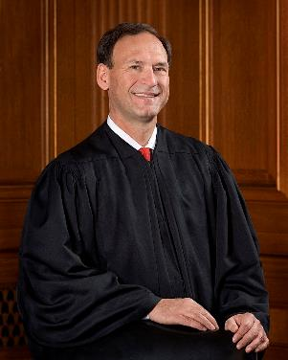
Carpenter v. United States (2018)
Dissenting:
Justice Alito distinguished between an actual search and an order “merely requiring a party to look through its own records and produce specified documents.”
4th Amendment - Privacy in a Digital Age,
Policing in America,
Search and Seizure
JUSTICE SAMUEL ALITO

Slide 42
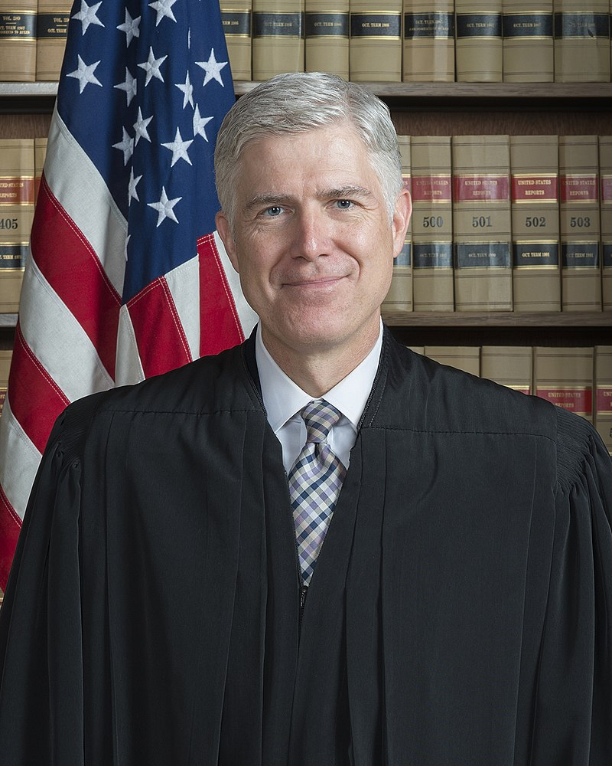
Carpenter v. United States (2018)
Dissenting:
Justice Gorsuch offered a thoughtful dissent—probing the limits of each of the proposed approaches while offering some tentative thoughts of his own.
4th Amendment - Privacy in a Digital Age,
Policing in America,
Search and Seizure
JUSTICE NEIL GORSUCH

Slide 43
Big Idea
Before the government can search your home or seize your property, it needs a good reason.
4th Amendment - Privacy in a Digital Age,
Policing in America,
Search and Seizure

