Slide 1
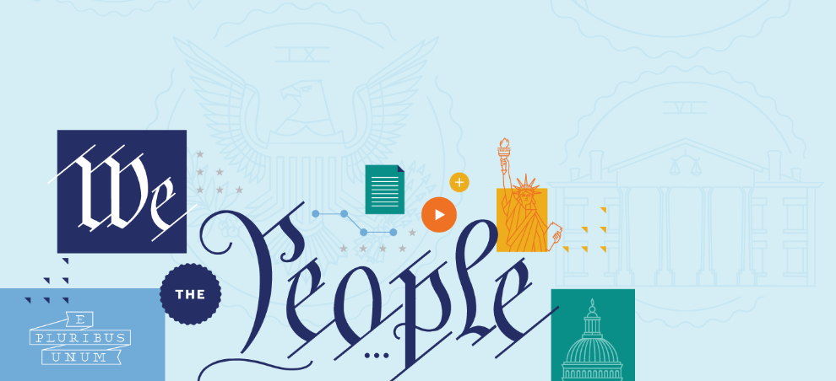
FIRST AMENDMENT: ASSEMBLY AND PETITION

Slide 2
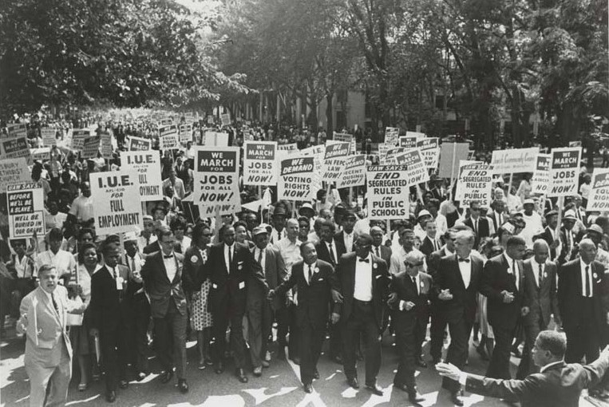
THE FIRST AMENDMENT AS A TOOL

Slide 3
THE FIRST AMENDMENT

Slide 4
THE FIRST AMENDMENT
RELIGION
SPEECH AND PRESS
ASSEMBLY AND PETITION
ESTABLISHMENT CLAUSE
FREE EXERCISE CLAUSE

Slide 5
BIG QUESTIONS
Why did the Founding generation include assembly and petition rights in the First Amendment?
How did the Founding generation exercise their assembly and petition rights?
How have constitutional movements throughout history used assembly and petition rights to push for constitutional change?
How has the Supreme Court addressed assembly rights over time?
What are some of the key constitutional debates over assembly and petition rights?
How can you assert your rights to freedom of assembly and petition today?

Slide 6
THE FIRST AMENDMENT
“Congress shall make no law respecting an establishment of religion, or prohibiting the free exercise thereof; or abridging the freedom of speech, or of the press; or the right of the people peaceably to assemble, and to petition the Government for a redress of grievances.”

Slide 7
THE FIRST AMENDMENT
First, the freedom of assembly protects our right to gather together with others in groups—whether as part of a political meeting, religious gathering, street protest, or parade.
Second, the right to petition goes to our right to join together with others to share our collective views with the government—often by highlighting problems and suggesting ways of fixing them.

Slide 8
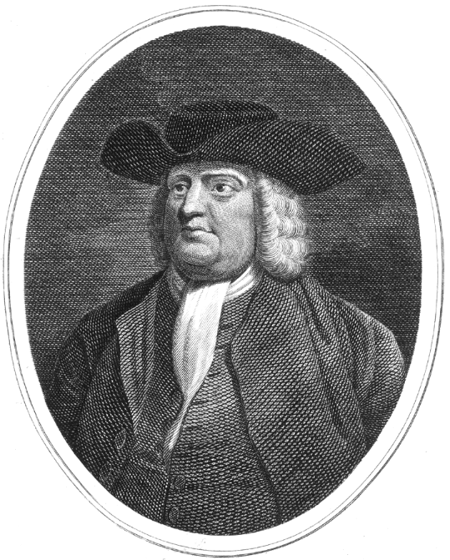
WILLIAM PENN
Notes:
https://www.archives.gov/historical-docs/todays-doc/index.html?dod-date=706

Slide 9
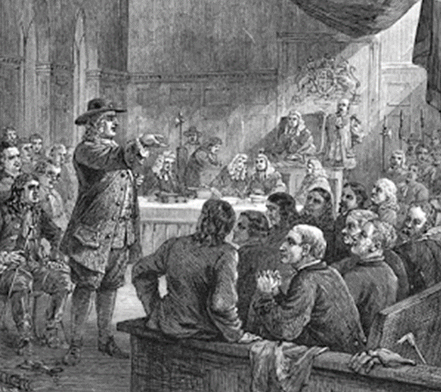
BUSHELL'S CASE —
THE PENN/MEAD TRIAL (1670)
Notes:
https://www.archives.gov/historical-docs/todays-doc/index.html?dod-date=706

Slide 10
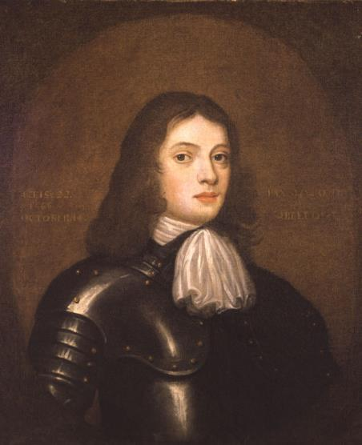
BUSHELL'S CASE —
THE PENN/MEAD TRIAL (1670)
“You are Englishmen; mind your privileges, give not away your right.”
-William Penn
William Penn, Age 22
Notes:
https://www.archives.gov/historical-docs/todays-doc/index.html?dod-date=706

Slide 11
FREEDOM OF ASSEMBLY
The freedom of assembly protects our right to gather together with others in groups—whether as part of a political meeting, religious gathering, street protest, or parade.

Slide 12
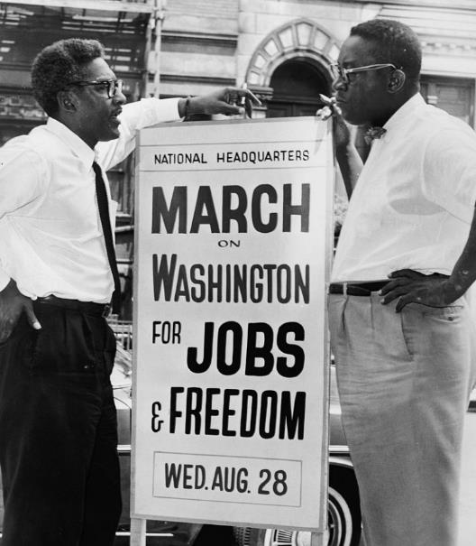
RIGHT OF ASSOCIATION
Bayard Rustin and Cleveland Robinson were key figures in planning the March on Washington.

Slide 13
RIGHT OF ASSOCIATION
The assembly right is the only right in the First Amendment that requires more than a lone individual. You can speak alone. But you can’t assemble alone. And while some assemblies occur spontaneously, most don’t. For this reason, the assembly right extends to the prep work before the physical act of gathering.
In part to protect this work, the Supreme Court eventually recognized a “right of association.”

Slide 14
EXPRESSIVE ASSOCIATION
Groups are eligible for constitutional protection to the extent that their purposes and activities further some other First Amendment interest like speech, press, or religion.

Slide 15
EXPRESSIVE ASSOCIATION
“Implicit in the right to engage in activities protected by the First Amendment” is “a corresponding right to associate with others in pursuit of a wide variety of political, social, economic, educational, religious, and cultural ends.”
Roberts v. United States Jaycees (1984)

Slide 16
BIG IDEA
Protects dissenters and unpopular groups, all groups. E.g., religious minorities, unpopular groups, labor activists, civil rights groups, etc. This can even include the right to protest and picket a military funeral.

Slide 17
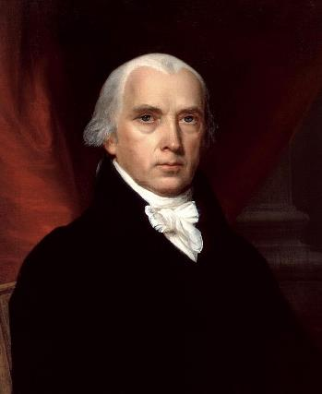
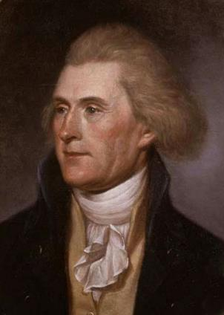
DEMOCRATIC-REPUBLICAN SOCIETIES
James Madison
Thomas Jefferson
Political organizations designed to build political opposition to the Federalist government.

Slide 18
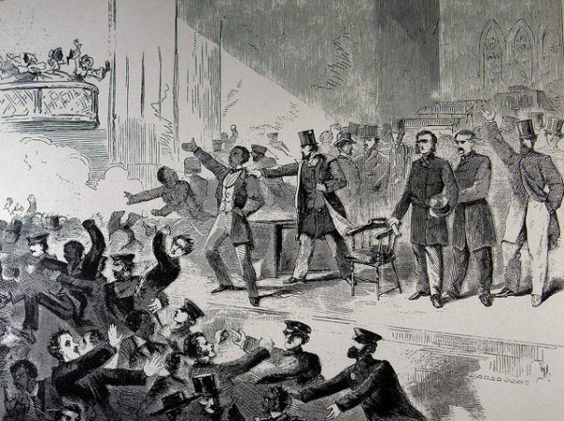
ABOLITIONISTS
A 1938 cartoon from Harper’s Weekly depicts an Pre-Civil War abolitionist meeting being broken up in Boston.

Slide 19
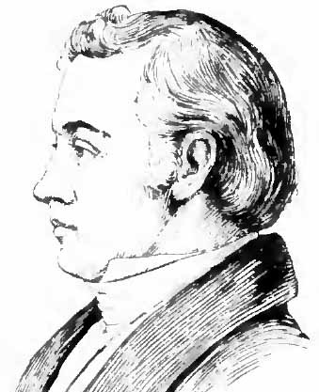
ABOLITIONISTS
Political and community leaders often organized mobs to suppress abolitionist meetings and expression—sometimes leading to violence and even death, perhaps most famously, that of Illinois printer Elijah Lovejoy in 1837
First Amendment: Assembly and Petition
Elijah Lovejoy

Slide 20
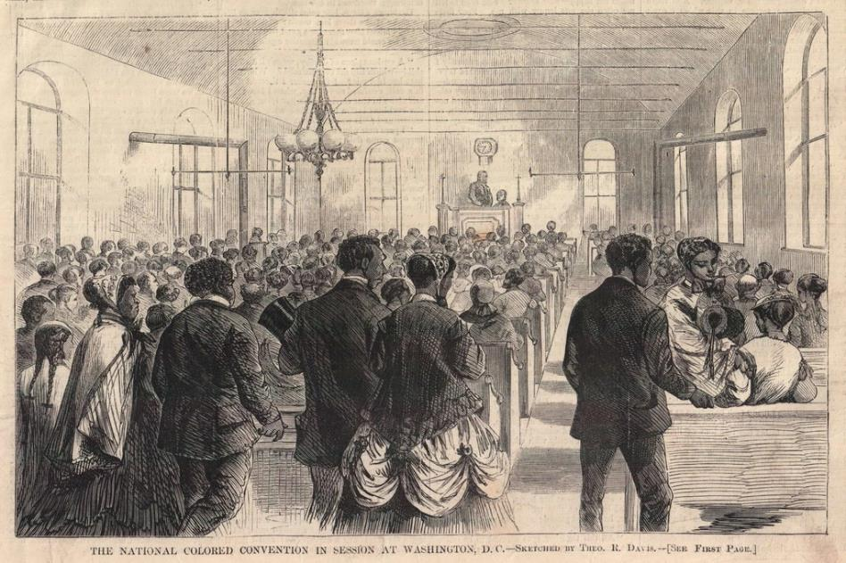
AFRICAN AMERICAN CONVENTIONS
An engraving of a “colored national convention” in Nashville in 1876, printed in Frank Leslie’s Illustrated Newspaper.

Slide 21
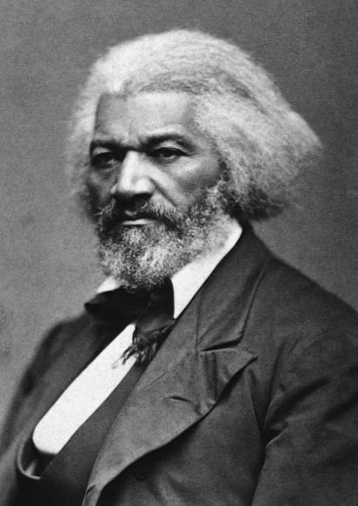
AFRICAN AMERICAN CONVENTIONS
Met before, during, and after the Civil War to offer a vision of freedom and equality for all Americans and demand these rights for African Americans.
For example, take Frederick Douglass’s “A Plea for Free Speech” in Boston 1860. There, Douglass calls for respecting the right to speech and assembly against mob violence.
Frederick Douglass

Slide 22
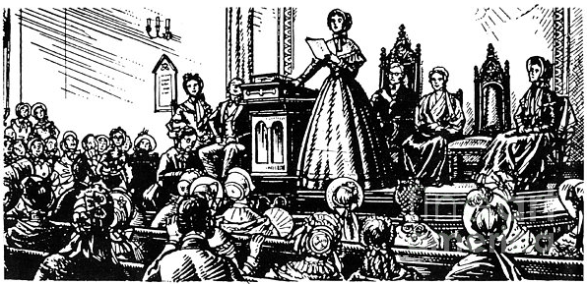
SUFFRAGISTS
Seneca Falls Convention, 1848

Slide 23
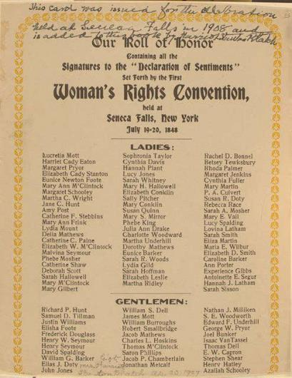
SUFFRAGISTS
The Seneca Falls Convention in 1848 produced one of the most famous documents in American history—the Declaration of Sentiments. It used the Declaration of Independence as its model—explaining a series of wrongs against women and advancing a vision of an America in which men and women were treated equally.

Slide 24
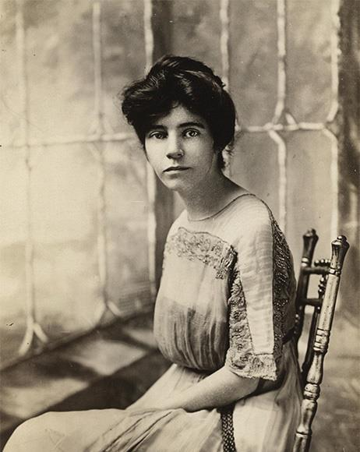
SUFFRAGISTS
After Woodrow Wilson’s reelection, in 1916, Alice Paul called for members of the National Women’s Party to picket the White House (this was the first ever protest at the White House) to put pressure on Democratic Senators to vote for the Nineteenth Amendment—protecting women’s right to vote.
Alice Paul

Slide 25
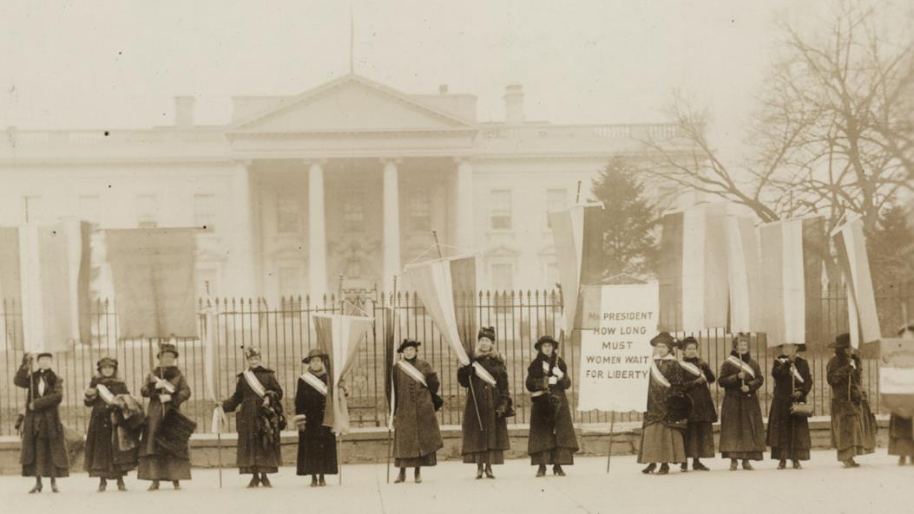
SUFFRAGISTS

Slide 26
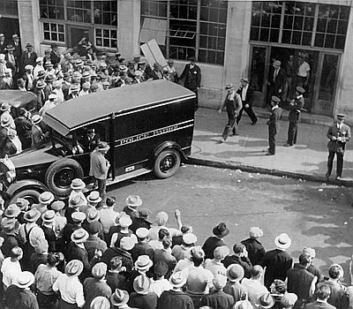
DE JONGE V. OREGON (1937)
Crowds and police wagon during the 1934 Portland general strike.

Slide 27
DE JONGE V. OREGON (1937)
The Supreme Court extended the right of assembly beyond the national government and applied it to state abuses—what lawyers call incorporation—in the unanimous 1937 decision—De Jonge v. Oregon.
The case involved a peaceful meeting of Communists in Oregon. The communists were arrested and tried for meeting as part of a group that sought to violently overthrow the government. The Supreme Court threw out the conviction and recognized that “the right of peaceable assembly is a right cognate to those of free speech and free press and is equally fundamental.”

Slide 28
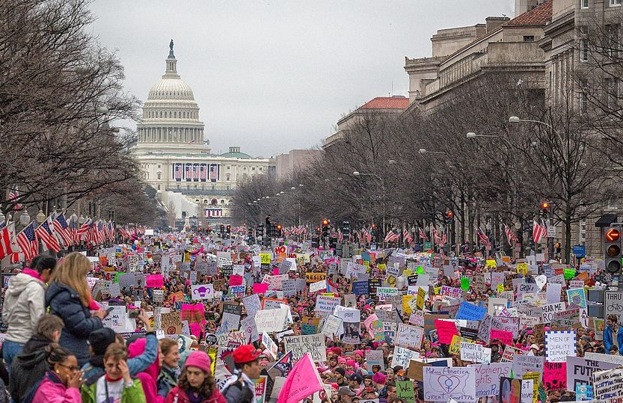
FREEDOM OF ASSEMBLY TODAY

Slide 29
FREEDOM OF ASSEMBLY TODAY
Most public gatherings—like protests—are governed by (what the Supreme Court refers to as) public forum doctrine. The idea is pretty simple in theory. The government is allowed to regulate expressive activity in public spaces—like protests and parades—through (what the Court calls) reasonable “time, place, and manner” restrictions.
The idea is that the government can’t restrict the message, but it can sometimes regulate when you say it—or how loudly you say it—in order to maintain the public’s health, safety, and welfare.

Slide 30
RIGHT TO PETITION
The petition right goes to our right to share our collective views with the government—often by highlighting problems and suggesting ways of fixing them.

Slide 31
BIG IDEA
The petition right goes to our right to share our collective views with the government—often by highlighting problems and suggesting ways of fixing them. And while the right to petition hasn’t played a large role at the Supreme Court, it has an important place in American constitutional history. The colonists used petitions to reach out to the British Crown in the colonial period, raising their complaints—with famous examples like John Dickinson’s “Olive Branch” petition. We used it to justify our split from England, with the Declaration of Independence following years of ignored petitions by the colonists to King George III.

Slide 32
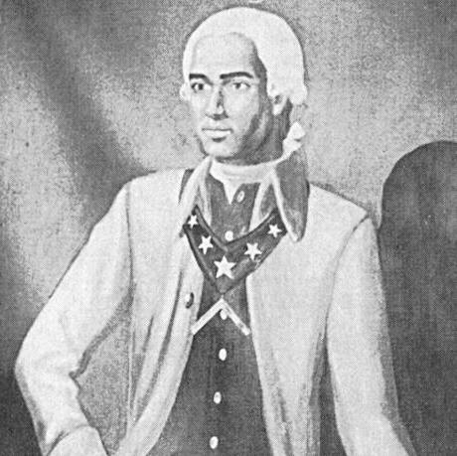
THE PETITION RIGHT AND THE FIGHT AGAINST SLAVERY, 1777
Prince Hall

Slide 33
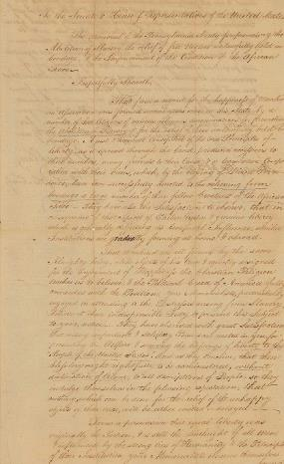
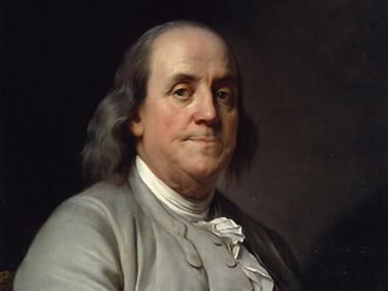
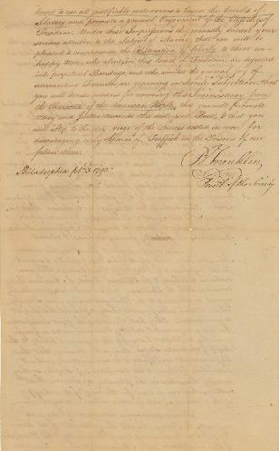
BENJAMIN FRANKLIN AND THE ABOLITION SOCIETY, 1790
Benjamin Franklin and the 1790 anti-slavery petition (from the Pennsylvania Anti-Slavery Society

Slide 34
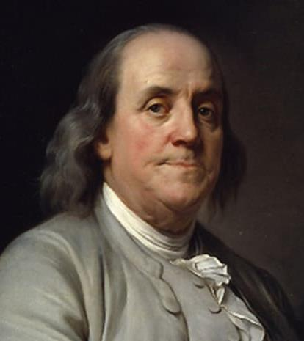
BENJAMIN FRANKLIN AND THE ABOLITION SOCIETY, 1790
It called for the First Congress to “devise a means for removing the Inconsistency from the Character of the American People” and “to promote mercy and justice towards this distressed Race”—namely, African Americans.
Benjamin Franklin

Slide 35
BENJAMIN FRANKLIN AND THE ABOLITION SOCIETY, 1790
The petition also read: “That mankind are all formed by the same Almighty being, alike objects of his care & equally designed for the Enjoyment of Happiness the Christian Religion teaches us to believe & the Political Creed of America fully coincides with the Position.” Here, “political creed” was a clear reference to the principles of the Declaration of Independence.

Slide 36
JAMES MADISON’S MEMORIAL AND REMONSTRANCE, 1785
Was circulated as a petition, which signaled public support and proved decisive in the Virginia legislature’s eventual decision to adopt its Bill for Establishing Religious Freedom—an important precursor to the First Amendment’s religion clauses.
James Madison

Slide 37
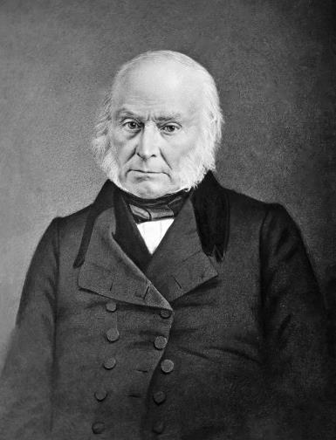
ANTI-SLAVERY PETITIONS AND THE “GAG RULE”, 1830s
John Quincy Adams—elected to the House after his Presidency—usually took the lead in introducing anti-slavery petitions in the House—provoking a near riot. The House leadership—driven by pro-slavery forces—responded by imposing a “gag rule” limiting petitions. This rule automatically tabled anti-slavery petitions, prohibiting them from being read or discussed.
John Quincy Adams

Slide 38
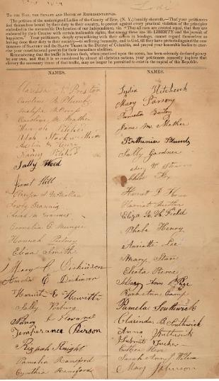
ANTI-SLAVERY PETITIONS AND THE “GAG RULE”, 1830s
Adams argued that the gag rule violated the First Amendment’s right “to petition the Government for a redress of grievances.” The petitions kept coming anyway—with 1,500 more between December 1838 and March 1839 alone—mostly about abolishing slavery in Washington D.C., ending the slave trade, and ending slavery’s expansion.
Image of petition sent to Congress during the 1830s

Slide 39
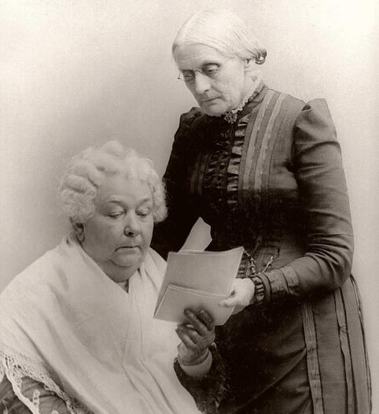
THIRTEENTH AMENDMENT PETITION DRIVE
In January 1864, Susan B. Anthony and Elizabeth Cady Stanton—through the Women’s Loyal National League—kicked off a petition drive in support of the abolition of slavery. The League presented Congress with a huge emancipation petition 100,000 signatures, nearly two-thirds of them, women.
Susan B. Anthony and Elizabeth Cady Stanton

Slide 40
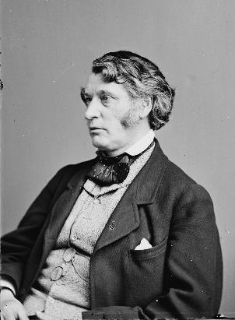
AFRICAN AMERICAN CONVENTIONS
Throughout the United States African Americans met in conventions to advance a vision of racial equality and used petitions to share their views with the government. In 1865, Charles Sumner offered a petition to the Joint Committee on Reconstruction from newly freed slaves in South Carolina calling for “constitutional protection in keeping arms, in holding public assemblies, and in complete liberty of speech and of the press.”
Charles Sumner

Slide 41
PETITIONS FOR WOMEN’S SUFFRAGE
Finally, in 1866, Susan B. Anthony and Elizabeth Cady Stanton spearheaded a petition drive that led thousands of women to petition Congress for the right to vote.
Susan B. Anthony and Elizabeth Cady Stanton

